Slide 1
Utero-Vaginal Prolapse
Dr. Sanskruti Tahakik
Dept. Of Community Physiotherapy
Mgm Institute Of Physiotherapy
Chh. Sambhajinagar

Slide 2
Contents
Introduction.
Risk factors.
Types of Prolapse.
Symptoms.
Management.

Slide 3
Uterine Prolapse
The condition refers to the bulging of or herniation of one or more pelvic organs into or out of the vagina.
Pelvic organ prolapse occur when the muscles, ligaments & fascia that holds these organs in their correct positions becomes weakened.

Slide 4
Risk factors for the development of prolapse
Confirmed Risk Factor
Older age.
Increased body mass index.
Higher parity Vaginal delivery.
Constipation.
Possible Risk Factor
Intrapartum variables (long second stage of labour , episiotomy, epidural analgesia)
Increased abdominal pressure.
Menopause.

Slide 5
When lack of adequate support allows the uterus to descend, it causes the vaginal vault to descend also and the vagina to invert.
After hysterectomy, some women may experience prolapse of the small intestine (enterocele) or the apex of the vagina (vaginal vault prolapse) secondary to loss of the support structures after removal of the uterus and cervix.
Such a prolapse will be associated with a cystocoele .

Slide 6
Normal pelvic anatomy looks like this:

Slide 7
The most common types of prolapse are:
Anterior wall prolapse (cystocele) – when the bladder bulges into the front wall of the vagina.

Slide 8
Posterior wall prolapse (rectocele) – when the rectum bulges into the back wall of the vagina.

Slide 9
Uterine prolapse – when the uterus hangs down into the vagina. Eventually the uterus may protrude outside the body. This is called a procidentia or third-degree prolapse.

Slide 10
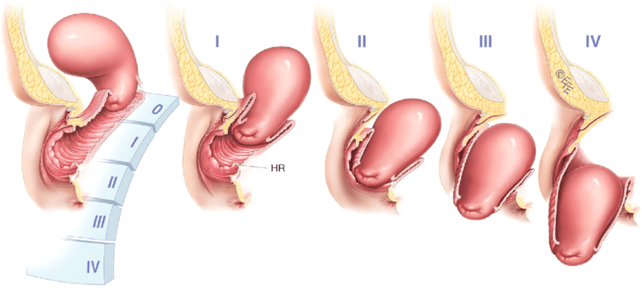

Slide 11
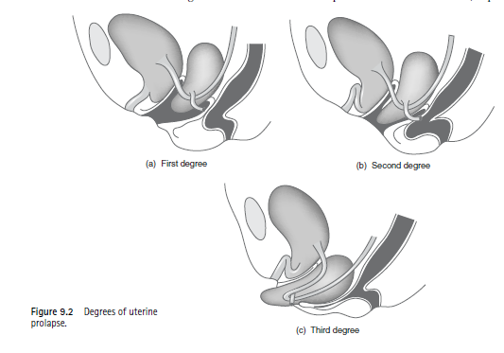
First degree - The cervix remains within the vagina.

Slide 12
Second degree – Descent of the cervix to the introitus, which may protrude further on straining, with the possibility of damage, infection and ulceration.

Slide 13
Third degree or procidentia - The entire uterus descends outside the introitus of the body, causing total inversion of the vagina.

Slide 14
Symptoms Attributable to Uterine Prolapse
Sensation of a bulge or protrusion
Seeing or feeling a bulge
Feeling of Pressure or heaviness in the vagina
Pain in vagina or perineum
Low back pain, which is eased with lying down
Abdominal pressure or pain
Blood stained & purulent discharge

Slide 15
Urinary Symptoms
Incontinence, frequency, or urgency
Weak or prolonged urinary stream
Feeling of incomplete emptying
Manual reduction to start or complete emptying
Change of position needed to start or complete voiding

Slide 16
Pelvic organ prolapse is diagnosed primarily by history and physical examination, Both the POP-Q and the Baden-Walker systems are used for the quantification of pelvic organ prolapse.

Slide 18
Baden-Walker systems

Slide 19
Management
Conservative modalities begin with exercises to strengthen the pelvic floor musculature (Kegel exercises).
Mechanical support devices (pessaries) may be used to manage prolapse and the associated symptoms, or
The defect may be repaired surgically.

Slide 20
Pelvic floor physical therapy with biofeedback is often used in conjunction to ensure that the patient is performing these exercises appropriately.
Although these may play a protective role in the Prevention of prolapse, the available literature does not support the notion that these measures reverse or treat existing symptomatic prolapse.

Slide 21
The mainstay of conservative management is the use of vaginal pessaries
Pessaries act as mechanical support devices to replace the lost structural integrity of the pelvis and to diffuse the forces of descent over a wider area.
Pessaries are indicated for any patient that desires nonsurgical management and those in whom surgery is contraindicated.

Slide 22
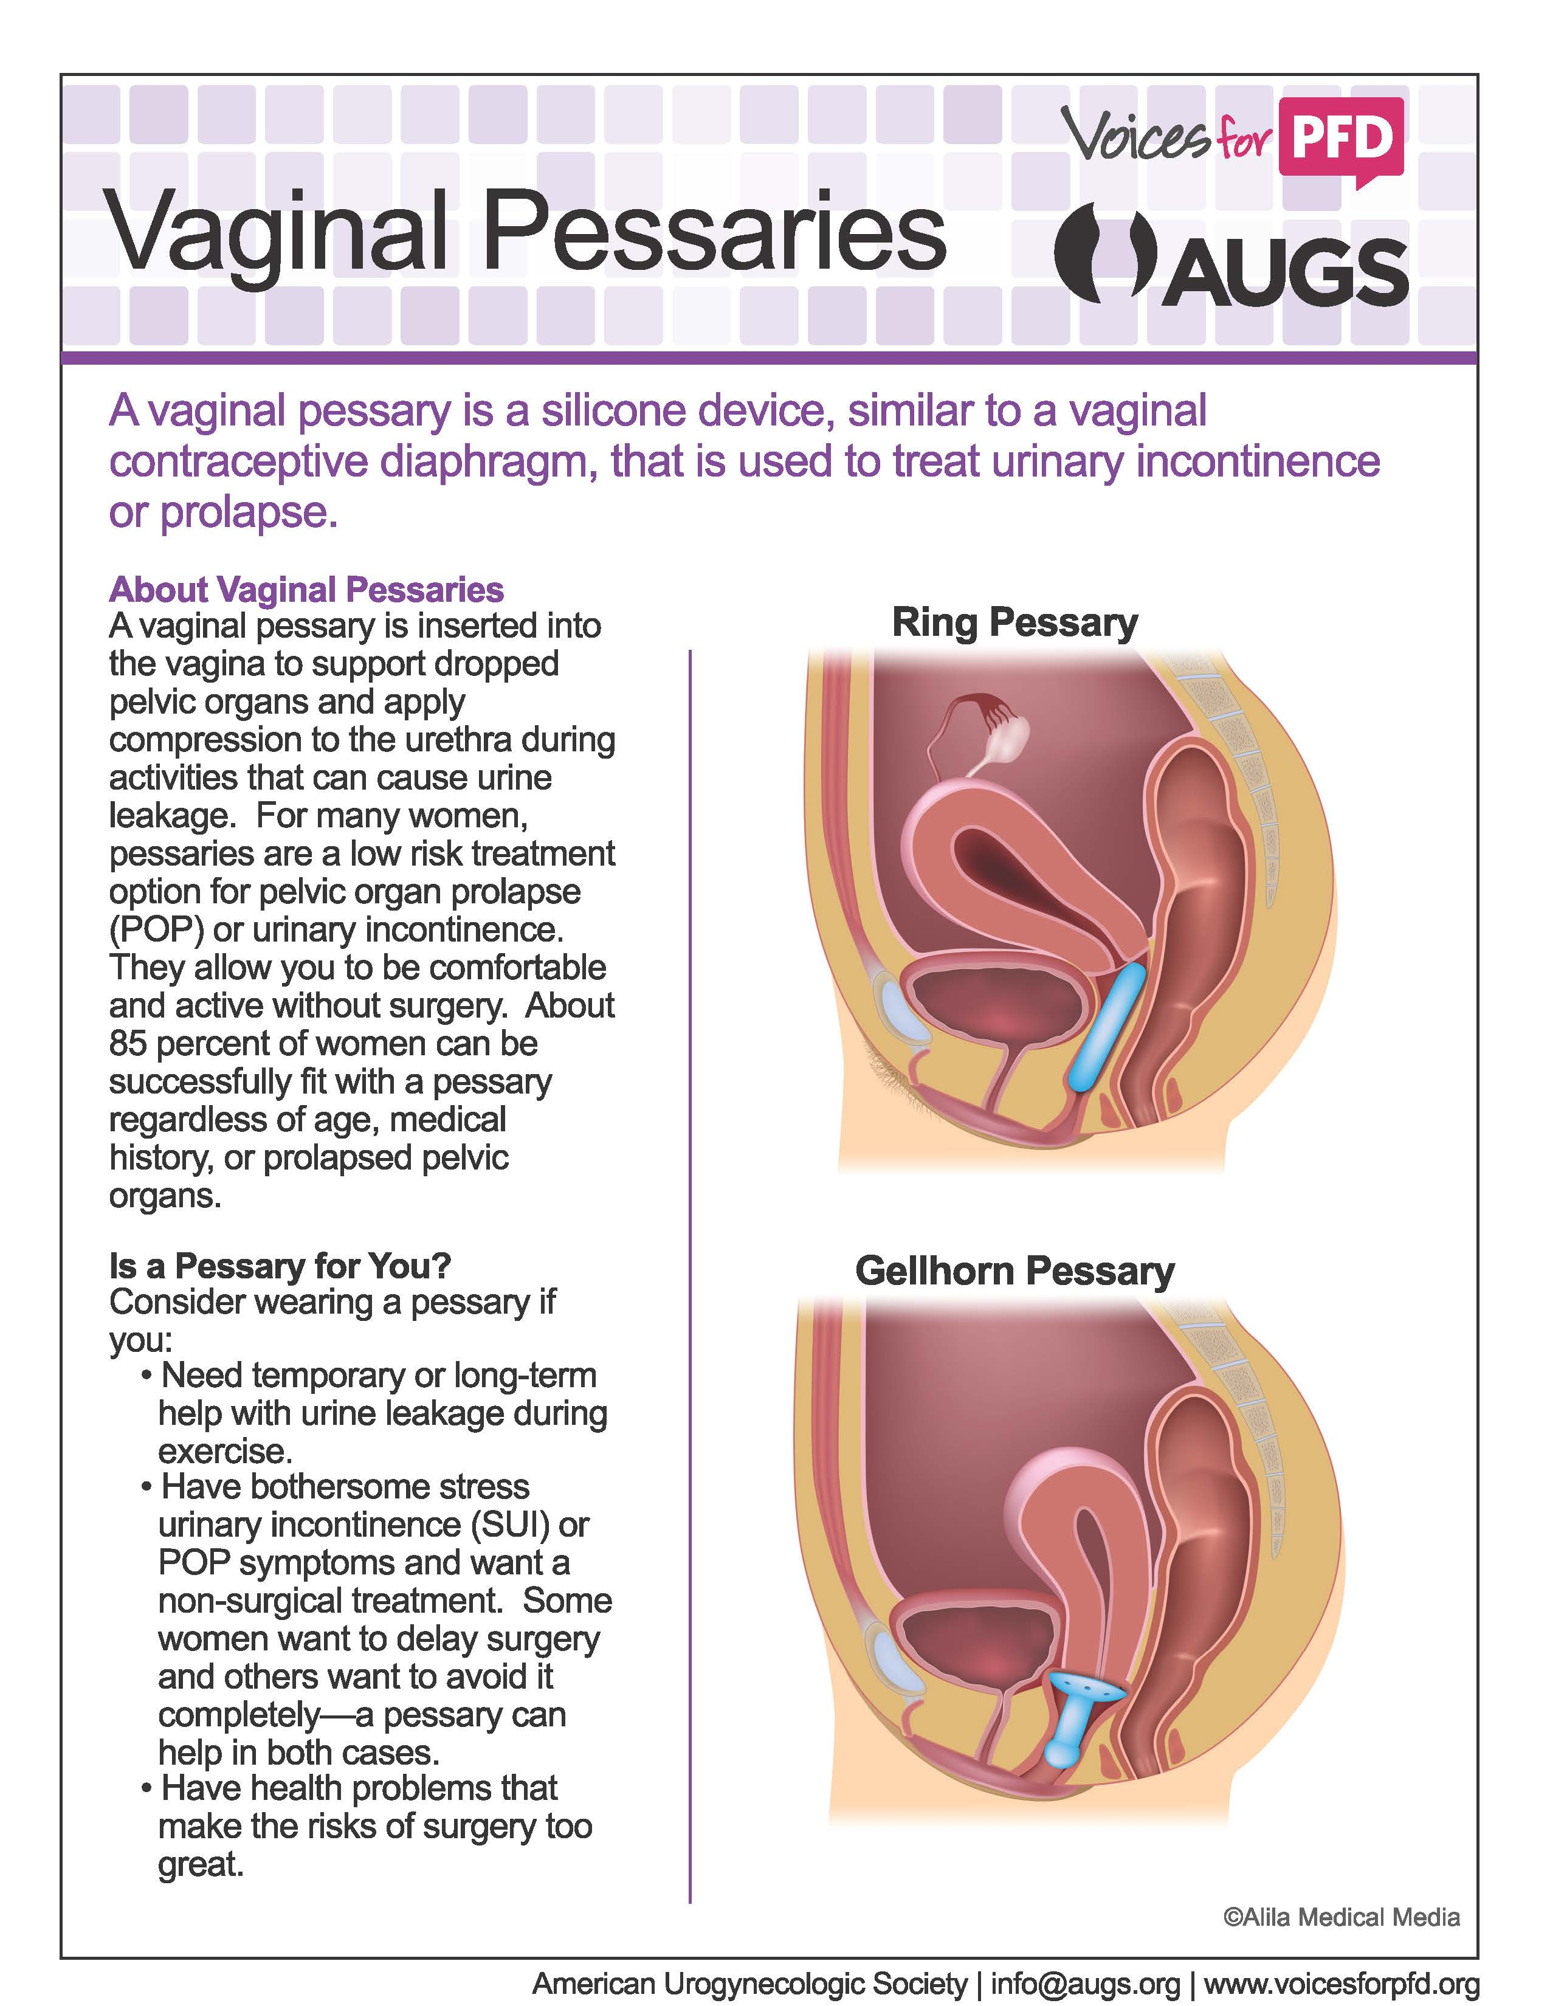

Slide 25
Vaginal hysterectomy (rather than Manchester repair) is now the treatment of choice for uterine prolapse.
This can be combined with an anterior or posterior repair (or both) if a cystocele or rectocele is present.

Slide 27
Summary
Pelvic organ prolapse is a general term used to denote a herniation of the anterior, apical, or posterior vaginal walls into the vaginal lumen.
Treatment of pelvic organ prolapse is guided by the severity of symptoms.
Pelvic organ prolapse can be treated non-surgically with Kegel exercises, pelvic floor physical therapy, and biofeedback. Vaginal pessary use is the mainstay of nonsurgical management of pelvic organ prolapse.

Slide 28
Most likely Questions

Slide 29
References
Physiotherapy in obstetrics and gynaecology By- Margaret Polden, & Jill Mantle 2nd edition.

Slide 30
Thank you…

